Slide 1
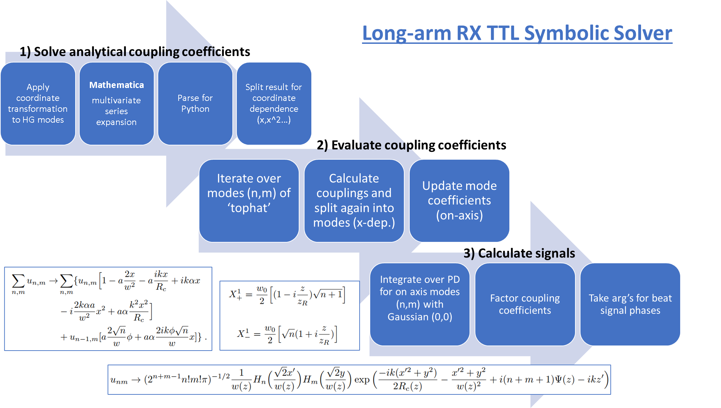
Paul E 9/25
SIM: Long-arm RX TTL Symbolic Solver for n^{th} order misalignment expansions
Completed HG00-HG00 portion
Completed documentation for Tophat-HG00 portion and started coding
EXP: Optical Truss Sideband Locking
VCO calibration
Monthly: Current setup pictures and draft diagrams of final setup

Slide 2
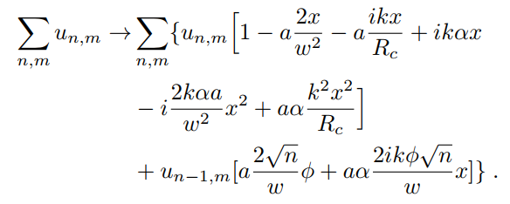
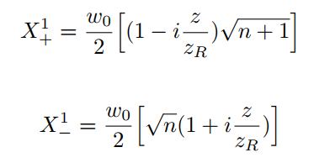
Mathematica
multivariate series expansion
Parse for Python
Split result for coordinate dependence (x,x^2…)
Apply coordinate transformation to HG modes
Long-arm RX TTL Symbolic Solver
1) Solve analytical coupling coefficients
Iterate over modes (n,m) of ‘tophat’
Calculate couplings and split again into modes (x-dep.)
Update mode coefficients (on-axis)
2) Evaluate coupling coefficients
Integrate over PD for on axis modes (n,m) with Gaussian (0,0)
Factor coupling coefficients
Take arg’s for beat signal phases
3) Calculate signals

Slide 3
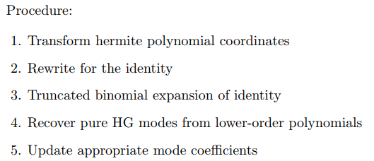




Tophat (Misaligned RX)
Nth order Expansions in tilt and shift

Slide 4
Rx-Tx beam | HG00-HG00
Plots | Regular and Total LPS [nm], DWS [rad] ; Slopes [nm/rad], [rad/rad]
Lateral offset | 10um
Tilt angle | [-500,500urad]
Longitudinal offset | 10mm
Expansion orders in tilt & shift | 1,2,3,4 in both (overall 2-8); 8/1 tilt/shift; Generalized (Alex)

Slide 5
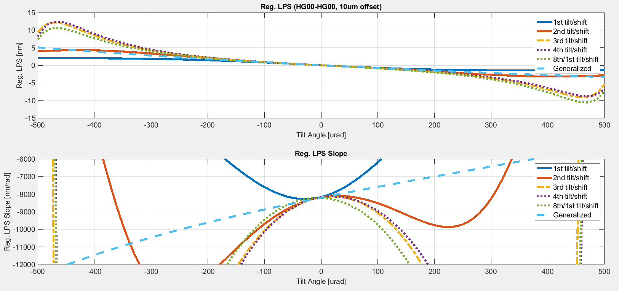
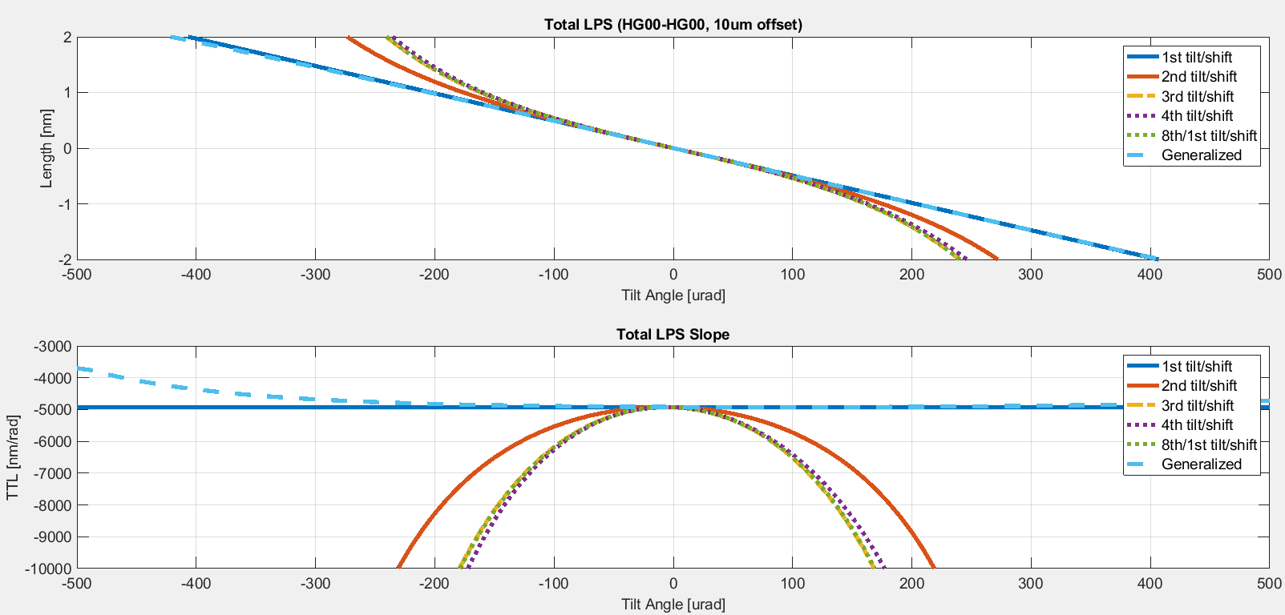
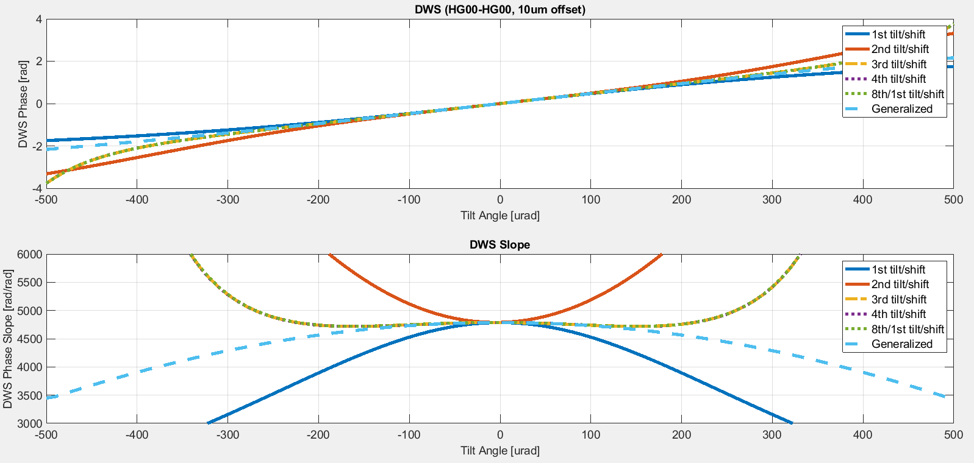
Rx-Tx beam | HG00-HG00
Plots | Regular and Total LPS [nm], DWS [rad] ; Slopes [nm/rad], [rad/rad]
Lateral offset | 10um
Tilt angle | [-500,500urad]
Longitudinal offset | 10mm
Expansion orders in tilt & shift | 1,2,3,4 in both; 8/1 tilt/shift; Generalized (Alex)

Slide 7
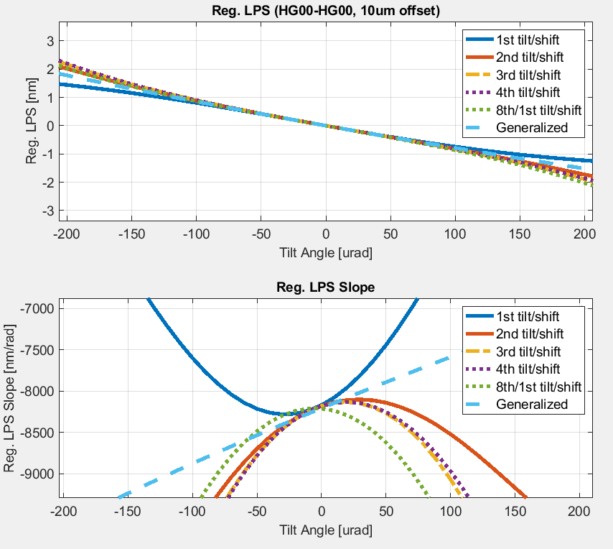

Slide 9
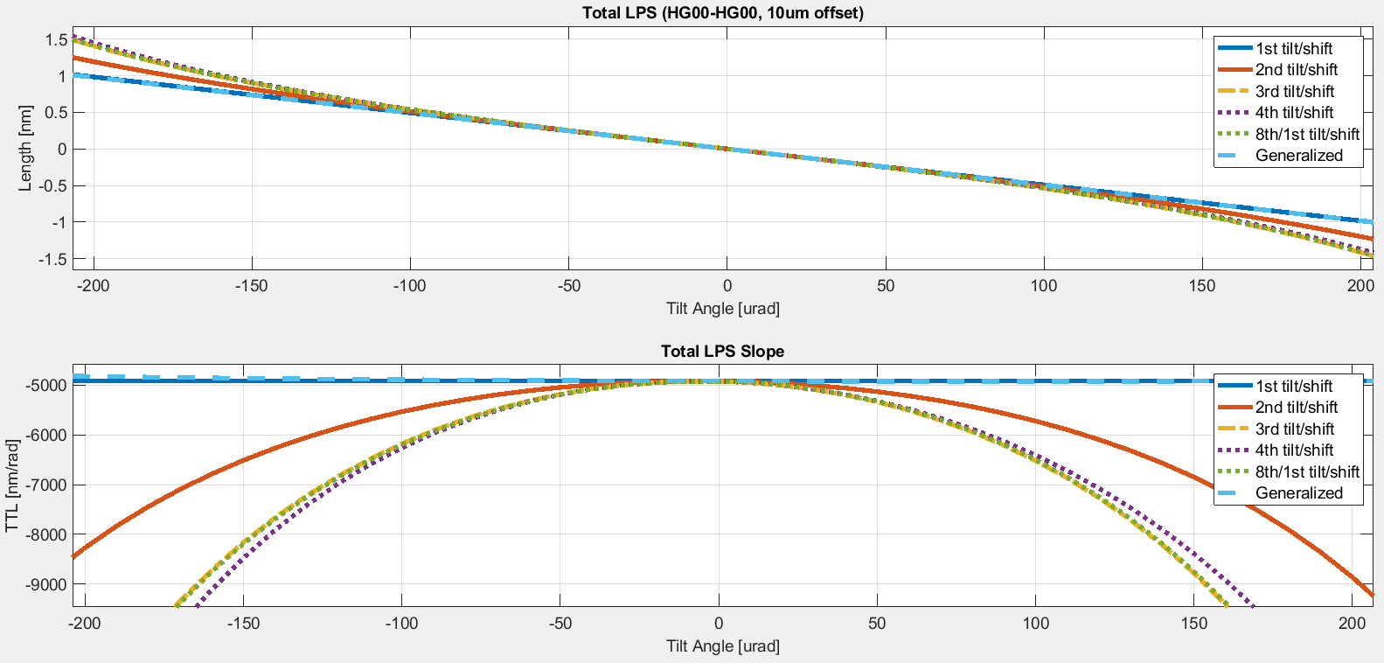

Slide 10
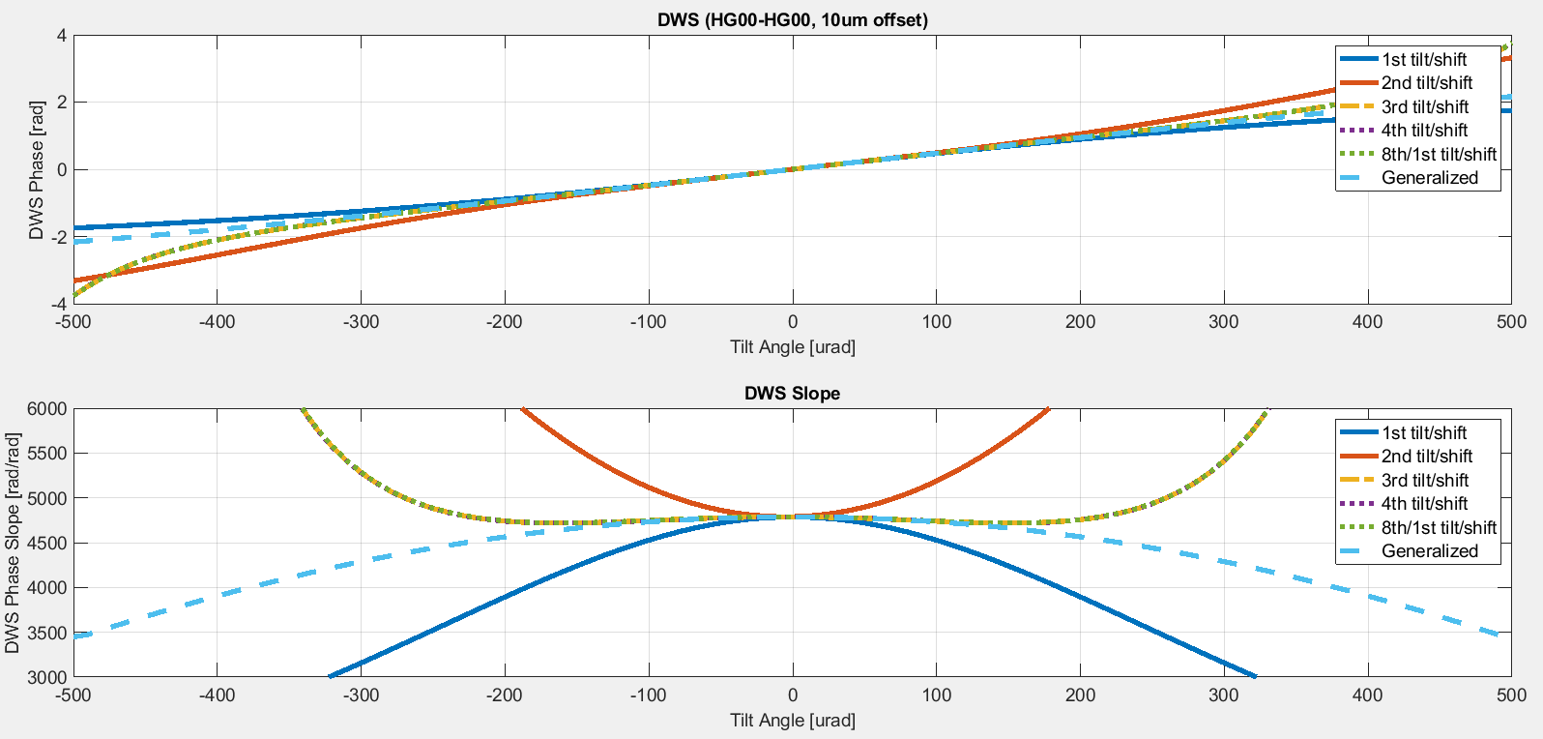

Slide 11
